Slide 1
Data Streaming
Dr. Salahuddin

Slide 2
streaming data
Streaming data is data that is generated continuously by thousands of data sources, which typically send in the data records simultaneously, and in small sizes (order of Kilobytes).
Streaming data includes a wide variety of data such as log files generated by customers using your mobile or web applications, ecommerce purchases, in-game player activity, information from social networks, financial trading floors, or geospatial services, and telemetry from connected devices or instrumentation in data centers.

Slide 3
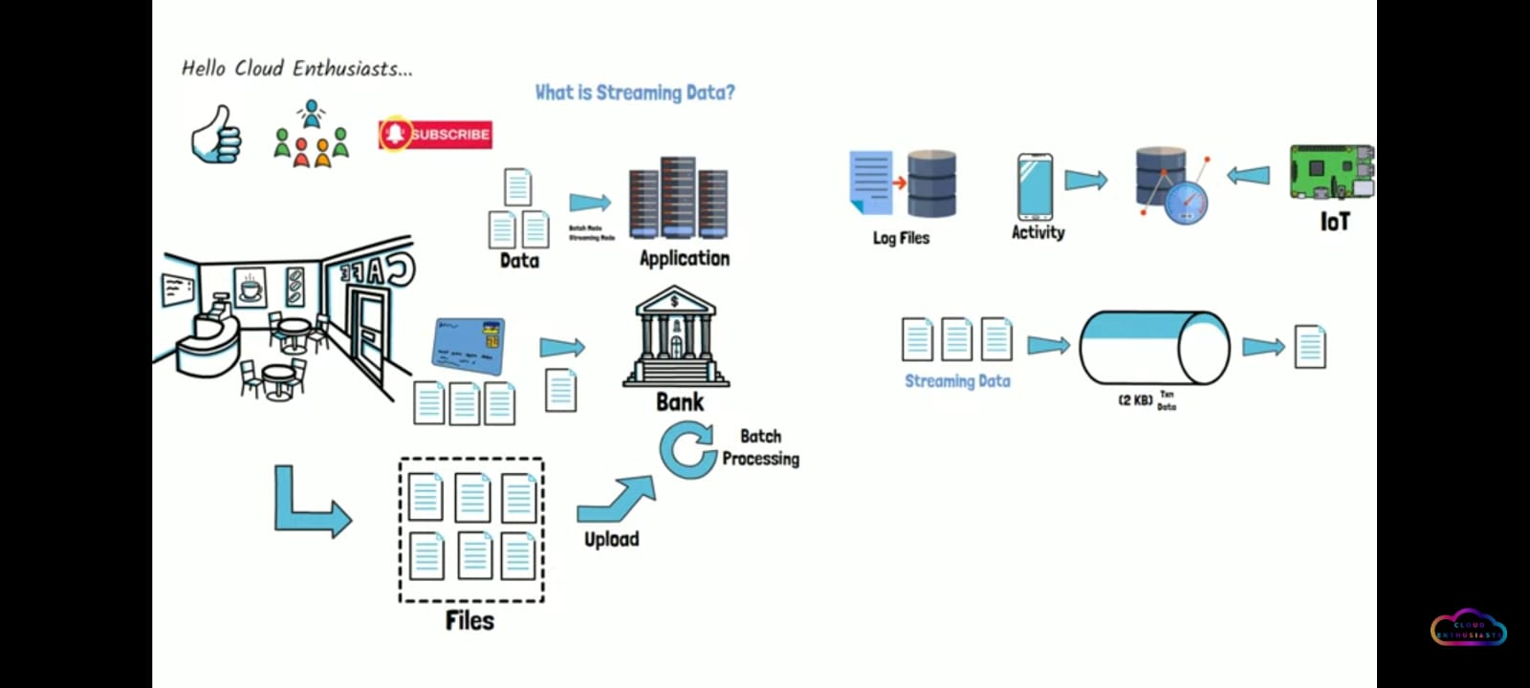
streaming data

Slide 4
streaming data
This data needs to be processed sequentially and incrementally on a record-by-record basis or over sliding time windows, and used for a wide variety of analytics including correlations, aggregations, filtering, and sampling.
Information derived from such analysis gives companies visibility into many aspects of their business and customer activity such as –service usage (for metering/billing), server activity, website clicks, and geo-location of devices, people, and physical goods –and enables them to respond promptly to emerging situations.
For example, businesses can track changes in public sentiment on their brands and products by continuously analyzing social media streams, and respond in a timely fashion as the necessity arises.

Slide 5
What Does Big Data Streaming Mean?
Big data streaming is a process in which big data is quickly processed in order to extract real-time insights from it.
The data on which processing is done is the data in motion.
Big data streaming is ideally a speed-focused approach wherein a continuous stream of data is processed.
Big data streaming is a process in which large streams of real-time data are processed with the sole aim of extracting insights and useful trends out of it. A continuous stream of unstructured data is sent for analysis into memory before storing it onto disk.
This happens across a cluster of servers. Speed matters the most in big data streaming. The value of data, if not processed quickly, decreases with time.

Slide 6
Two ways to inject our Data
1. Batch Process
2. Stream Process
Batch processing can be used to compute arbitrary queries over different sets of data. It usually computes results that are derived from all the data it encompasses, and enables deep analysis of big data sets. MapReduce-based systems, like Amazon EMR (Elastic Map Reduce), are examples of platforms that support batch jobs.
In contrast, stream processing requires ingesting a sequence of data, and incrementally updating metrics, reports, and summary statistics in response to each arriving data record. It is better suited for real-time monitoring and response functions.

Slide 7
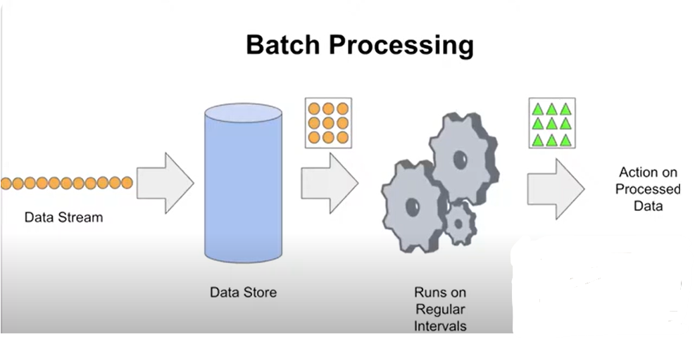
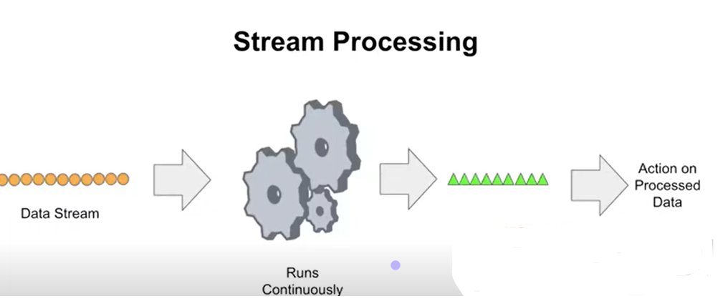

Slide 8
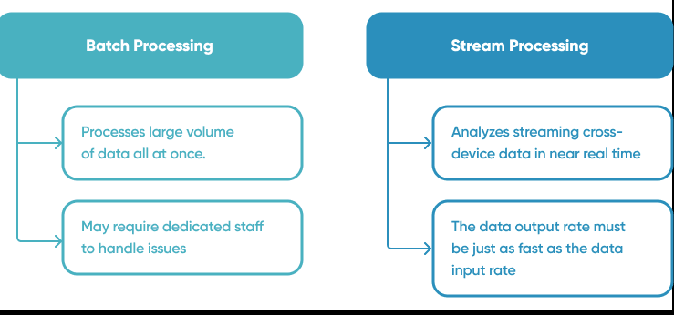
Two ways to inject our Data

Slide 9
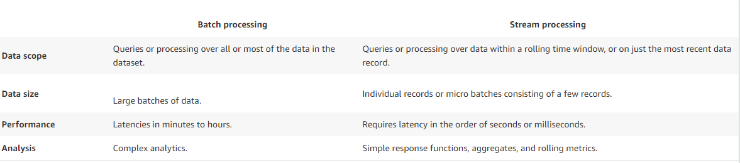
Two ways to inject our Data

Slide 10
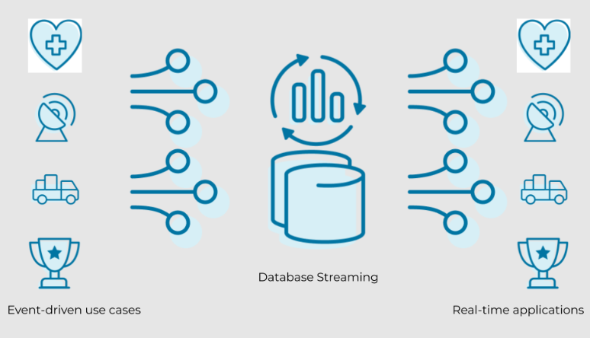
How Streaming Data Works - Overview, Examples, and Architecture

Slide 11
How Streaming Data Works - Overview, Examples, and Architecture
In previous years, legacy infrastructure was much more structured because it only had a handful of sources that generated data.
The entire system could be architected in a way to specify and unify the data and data structures.
With the advent of stream processing systems, the way we process data has changed significantly to keep up with modern requirements.

Slide 12
Overview of Stream Data Processing
Today's data is generated by an infinite amount of sources - IoT sensors, servers, security logs, applications, or internal/external systems. It’s almost impossible to regulate structure, data integrity, or control the volume or velocity of the data generated.
While traditional solutions are built to ingest, process, and structure data before it can be acted upon, streaming data architecture adds the ability to consume, persist to storage, enrich, and analyze data in motion.

Slide 13
Overview of Stream Data Processing
As such, applications working with data streams will always require two main functions: storage and processing. Storage must be able to record large streams of data in a way that is sequential and consistent. Processing must be able to interact with storage, consume, analyze and run computation on the data.
This also brings up additional challenges and considerations when working with legacy databases or systems. Many platforms and tools are now available to help companies build streaming data applications.

Slide 14
Examples
Some real-life examples of streaming data include use cases in every industry, including real-time stock trades, up-to-the-minute retail inventory management, social media feeds, multiplayer game interactions, and ride-sharing apps.
For example, when a passenger calls Lyft, real-time streams of data join together to create a seamless user experience. Through this data, the application pieces together real-time location tracking, traffic stats, pricing, and real-time traffic data to simultaneously match the rider with the best possible driver, calculate pricing, and estimate time to destination based on both real-time and historical data.
In this sense, streaming data is the first step for any data-driven organization, fueling big data ingestion, integration, and real-time analytics.

Slide 15
Batch Processing vs Real-Time Streams
Batch data processing methods require data to be downloaded as batches before it can be processed, stored, or analyzed, whereas streaming data flows in continuously, allowing that data to be processed simultaneously, in real-time the second it's generated.
Today, data arrives naturally as never ending streams of events. This data comes in all volumes, formats, from various locations and cloud, on-premises, or hybrid cloud.
With the complexity of today's modern requirements, legacy data processing methods have become obsolete for most use cases, as it can only process data as groups of transactions collected over time. Modern organizations need to act on up-to-the-millisecond data, before the data becomes stale. This continuous data offers numerous advantages that are transforming the way businesses run.

Slide 16
Benefits of Streaming Data
Data collection is only one piece of the puzzle. Today’s enterprise businesses simply cannot wait for data to be processed in batch form. Instead, everything from fraud detection and stock market platforms, to ride share apps and e-commerce websites rely on real-time event streams.
Paired with streaming data, applications evolve to not only integrate data, but process, filter, analyze, and react to event as they happen in real-time. This opens a new plethora of use cases such as real-time fraud detection, Netflix recommendations, or a seamless shopping experience across multiple devices that updates as you shop.
In short, any industry that deals with large volumes of real-time data can benefit from continuous, real-time event stream processing platforms.

Slide 17
Benefits of Streaming Data
High Returns: By processing data in real-time, organizations are able to make timely and informed decisions, which can lead to increased efficiency, improved customer experiences, and even cost savings. For example, in the financial industry, data streaming can be used to detect fraudulent transactions in real-time, which can prevent losses and protect customer information. In retail, data streaming can be used to track inventory in real-time, which can help businesses to optimize their supply chain and reduce costs.
Lesser Infrastructure Cost: In traditional data processing, large amounts of data are typically collected and stored in data warehouses, which can be costly in terms of storage and hardware expenses. However, with stream processing, data is processed in real-time as it is generated, which eliminates the need to store large volumes of data. This can greatly reduce the cost of storage and hardware, as organizations don’t need to maintain large data warehouses.

Slide 18
Challenges Building Data Streaming Applications
Scalability: When system failures happen, log data coming from each device could increase from being sent a rate of kilobits per second to megabits per second and aggregated to be gigabits per second. Adding more capacity, resources and servers as applications scale happens instantly, exponentially increasing the amount of raw data generated. Designing applications to scale is crucial in working with streaming data.
Ordering: It is not trivial to determine the sequence of data in the data stream and very important in many applications. A chat or conversation wouldn’t make sense out of order. When developers debug an issue by looking an aggregated log view, it’s crucial that each line is in order. There are often discrepancies between the order of the generated data packet to the order in which it reaches the destination. There are also often discrepancies in timestamps and clocks of the devices generating data. When analyzing data streams, applications must be aware of its assumptions on ACID (Atomicity, Consistency, Isolation, and Durability) transactions.

Slide 19
Challenges Building Data Streaming Applications
Consistency and Durability: Data consistency and data access is always a hard problem in data stream processing. The data read at any given time could already be modified and stale in another data centre in another part of the world. Data durability is also a challenge when working with data streams on the cloud.
Fault Tolerance & Data Guarantees: these are important considerations when working with data, stream processing, or any distributed systems. With data coming from numerous sources, locations, and in varying formats and volumes, can your system prevent disruptions from a single point of failure? Can it store streams of data with high availability and durability?

Slide 20
Use Cases of Data Streaming
Information about your location.
Detection of fraud.
Live stock market trading.
Analytics for business, sales, and marketing.
Customer or user behaviour.
Reporting on and keeping track of internal IT systems.
Troubleshooting systems, servers, gadgets, and more via log monitoring.
SIEM (Security Information and Event Management): Monitoring, metrics, and threat detection using real-time event data and log analysis.

Slide 21
Use Cases of Data Streaming
Retail/warehouse inventory: A smooth user experience across all devices, inventory management across all channels and locations.
Matching for ridesharing: Matching riders with the best drivers based on proximity, destination, pricing, and wait times by using location, user, and pricing data for predictive analytics.
AI and machine learning: This opens up new opportunities for predictive analytics by fusing the past and present data into one brain.

Slide 22
Source
https://hevodata.com/learn/data-streaming/#vs
https://www.confluent.io/learn/data-streaming/
https://www.techopedia.com/definition/31752/big-data-streaming
https://aws.amazon.com/streaming-data/

